Slide 1
KING ARTHUR’S FAMILY TREE

Slide 2
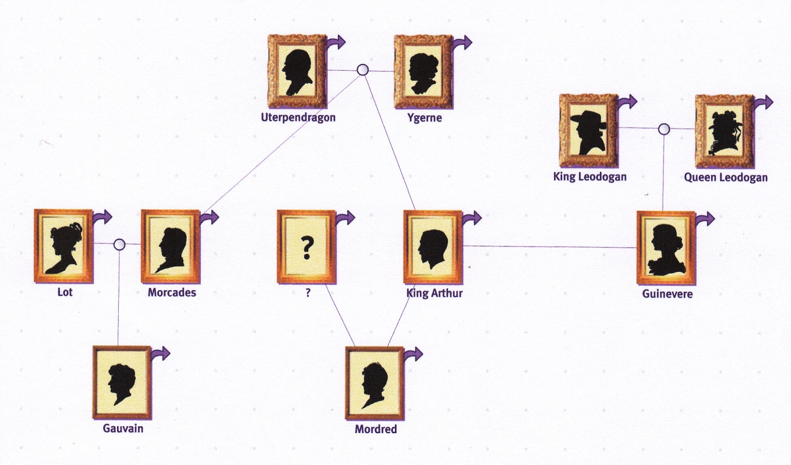

Slide 3
Complete these sentences with the right word: grand-father/ grand-mother, husband/wife, father/ mother, uncle/ aunt, son/ daughter, brother/sister, cousin.
1-Arthur is Utherpendragon’s _____________ and his _________________ is Guinevere.

Slide 4
1-Arthur is Utherpendragon’s son and his wife is Guinevere.

Slide 5
2-Guinevere is king and queen Leodogan’s_______.
Her ____________ is Arthur.

Slide 6
2-Guinevere is king and queen Leodogan’s daughter.
Her husband is Arthur.

Slide 7
3-King Arthur has got a ____________: Mordred.
His ______________ is Utherpendragon and his________________ is Ygerne.

Slide 8
3-King Arthur has got a son: Mordred.
His grandfather is Utherpendragon and his grandmother is Ygerne.

Slide 9
4-Mordred has got a ____________________: Gauvain.
Gauvain’s ____________, Morcades is Athur’s ____________________.
Gauvain’s_____________ is Lot.
Notes:
4-Mordred has got a ______________________: Gauvain. Gauvain’s _________________, Morcades is Athur’s ________________________. Gauvain’s _____________________ is Lot.

Slide 10
4-Mordred has got a cousin: Gauvain.
Gauvain’s father, Morcades is Athur’s brother.
Gauvain’s mother is Lot.

Slide 11
5- Mordred’s ____________ is Morcades and his _____________________ is Lot.
Mordred hasn’t got any ___________________ and Guinevere is not Mordred’s _____________________!

Slide 12
5- Mordred’s uncle is Morcades and his aunt is Lot.
Mordred hasn’t got any sisters and Guinevere is not Mordred’s mother.

